Slide 1
Lecture 4: E-business Applications – Chapter 7 & 8
Dr. Taysir Hassan Abdel Hamid

Slide 2
What is E-business?
E-business is the use of Internet technologies to internetwork and empower:
  business processes,
  electronic commerce,
  and enterprise communications
  and collaboration
  Within its customers, suppliers, and other business stakeholders.

Slide 3
Amazon.com:
Challenges of an E-Commerce Leaders
Spring 2000 - $900 million
Amazon’s core E-tailing business
Amazon’s 7,500 employees -- $1.6 billion
18 million customers
Books, music, etc
Amazon has bought companies

Slide 4
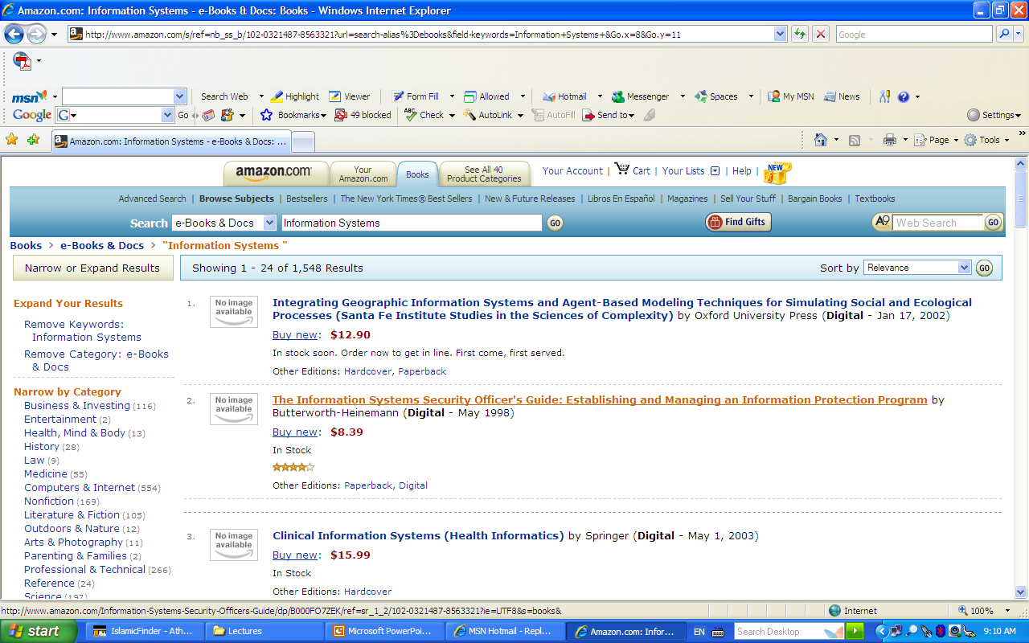

Slide 5
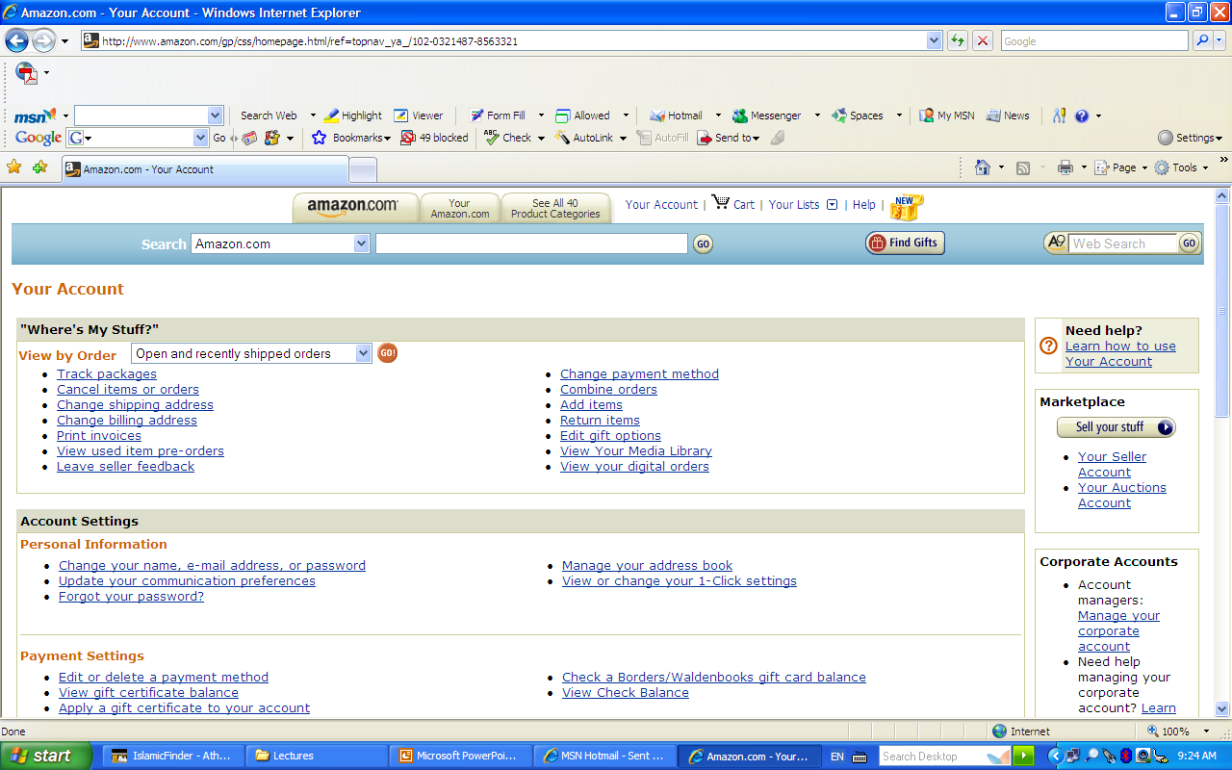

Slide 6
Amazon Practice Technologies
In the early years, the entire Amazon.com system was written in "C", which is an open-source software program language most commonly used on UNIX systems. C was supported by Perl, a computer language that enables users to manipulate and edit the contents of text files.
Search features
Payroll

Slide 7
E-Commerce - Amazon - Effective Web Applications
As with all web applications, the success of Amazon.com's site is based on two strong models:
Conceptual model is based on the concept of a reference catalogue, which helps Amazon.com to uniform product categories.
Structural model looks like a hub. The center of the hub contains the product details and category index pages and the spokes link to functional areas, such as checkout and account management.

Slide 8
Amazon.com
Amazon - 1 Click Shopping
Amazon - Branding
Amazon - Business Model
Amazon - Corporate Culture
Amazon - Customer Interface
Amazon - Customer Review Program
Amazon - Customer Service
Amazon - Effective Web Applications
Amazon - History And Development
Amazon - International store
Amazon - Online advertising and promotion
Amazon - Partnership
Amazon - Practice Technologies
Amazon - Public Relations
Amazon - The Associates Program

Slide 9

Internetworked E-Business
E-commerce Web Site
Internet Links
Customer and Marketing services
Electronic commerce
Service
Internetworked
E-Business Enterprise
Supply Chain Management Services
Customers
Accounting, Finance,
HR services
Suppliers
Other Company Locations

Slide 10
Sun Microsystems
One of the pioneers in the use of intranets in business, first implementing an intranet in 1994.
SunWeb is huge with over 3,000 intranet web servers to almost 20,000 employees who support web servers available at 100 countries
A variety of applications and services any business can offer through an intranet

Slide 11
Sun Microsystems
Views- there are three different views of the system:
  An organizational
  A functional (corporate, HR, sales, marketing)
  Geographical (all different locations)
What’s new – provides recent press releases for the company, online video and reports and company quarterly magazines.
Library and Education – internal and external training course offerings, company’s libraries for access to research services.

Slide 12
Sun Microsystems
Marketing & Sales – Marketing and sales databases, comparative information, marketing tools, organization information.
Product catalog – Contains multimedia information on all sun products
Engineering info – Provides all software tools that are available on each person’s local file server
Travel – Explains how to prepare a travel expense authorization, provides current travel advisories for foreign countries, links to international security.

Slide 13
Sun Microsystems
HR & Benefits – information about employee benefits, a manager’s handbook, a developer’s toolkit
Sun Campus – provides maps to all the different locations and buildings in the Bay area, including local directories and phone numbers.
Executive Suite – provides external links to an “executive suite” of business references on the Internet and on the world wide web
Construction Kit- contains the how-tos forbuilding websites on the SunWeb intranet, including policies and procedure, templates, graphics, clip art, and links to new software tools.

Slide 14
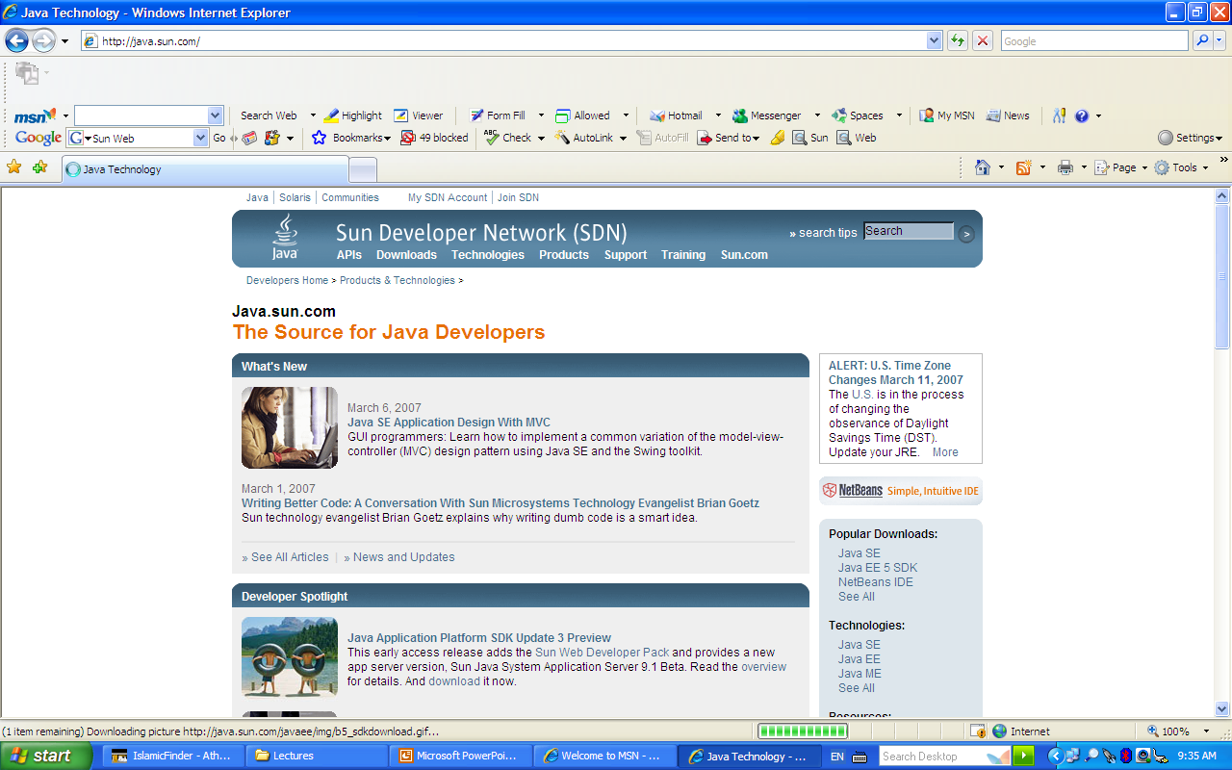

Slide 15
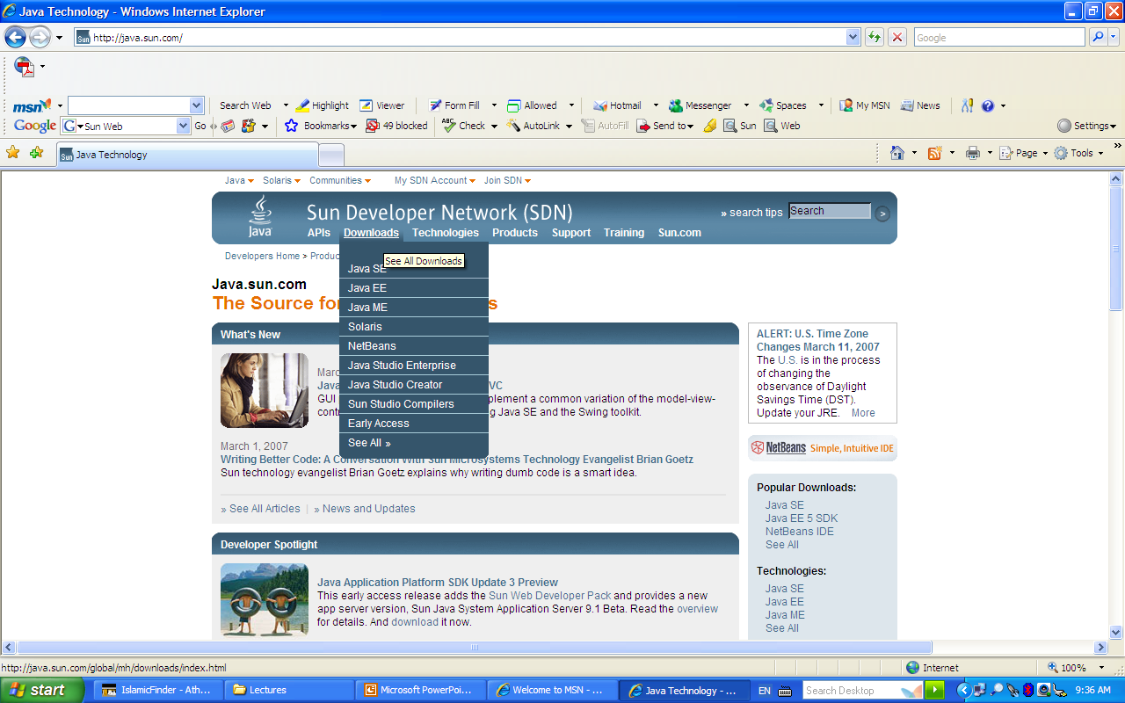

Slide 16
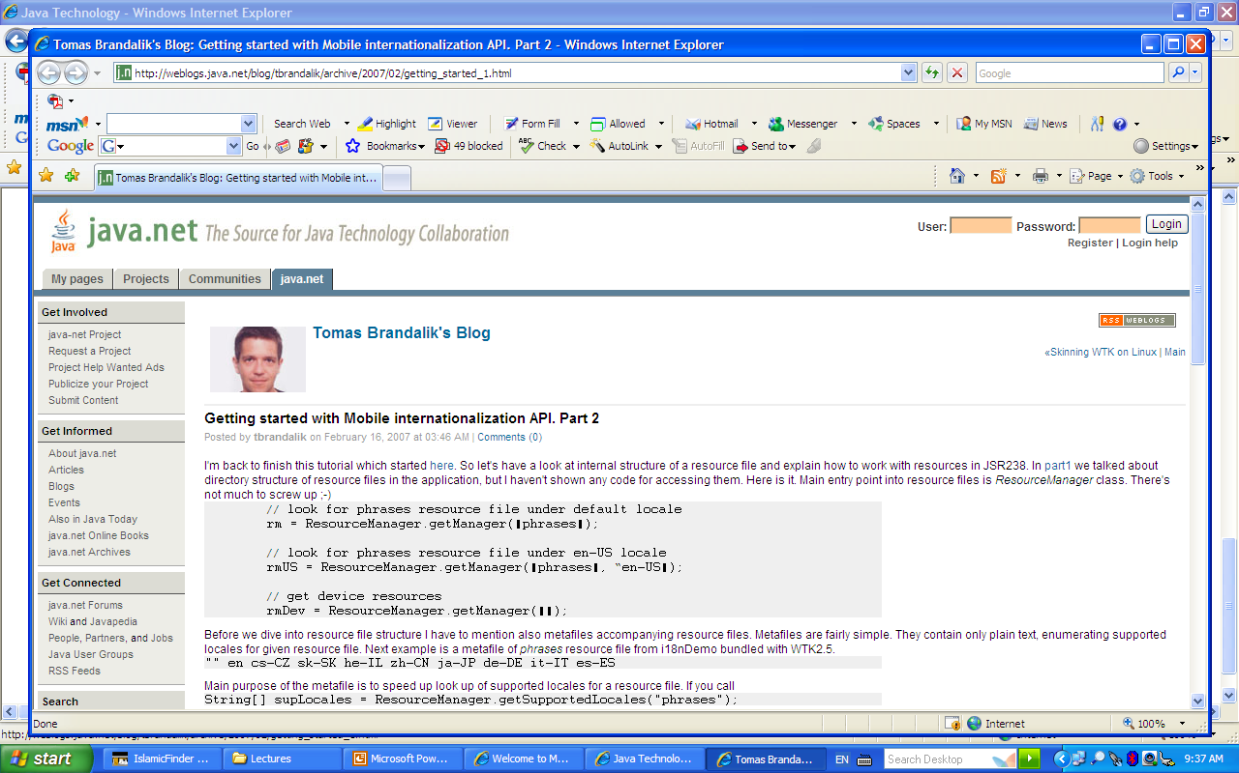

Slide 17
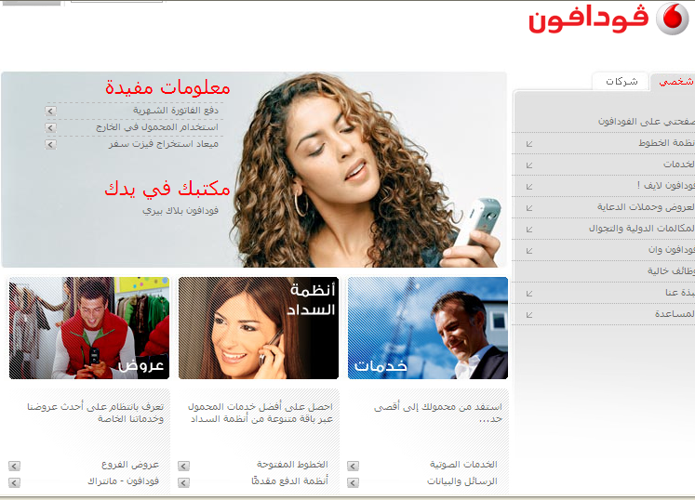
Example of
E-commerce

Slide 18
Enterprise Communication and Collaboration
The goal of enterprise collaboration systems is to enable us to work together more easily and effectively by helping us to:
Communicate: Sharing information with each other
Coordinate: Coordinating our individual work efforts and use of resources with each other.
Collaborate: Working together cooperatively on joint projects and assignments

Slide 19
The Intranet Way of Sharing Information
Author Web Page
Post on the Web Server
Links from Other pages
Links in E-mail
Web browsing
Push Netcast

Slide 20
Groupware for
Enterprise
Collaboration
Electronic
Communication
Tools
Electronic
Conferencing
Tools
Collaborative
Work
Management
Tools
Data Conferencing
Voice conferencing
Video Conferencing
Discussion Forums
Chatting
Electronic Meeting Systems
Calendaring and scheduling
Task and project management
Workflow systems
Document sharing
Knowledge Management
E-mail
Voice Mail
Faxing
Web Publishing
Internet Phone

Slide 21
Electronic Conferencing Tools
Data and voice conferencing are frequently mentioned together because they are used together in work situations.
Voice conferencing relied on speaker-phone systems but now can be accomplished with browser modules like Microsoft NetMeeting.
Data conferencing is also called whiteboarding.
Data conferencing – a groupware package connects two or more PCs over the Internet or intranets so a team can share, markup, and revise a whiteboard of drawing, documents, and other materials

Slide 22
Electronic Conferencing Tools
Videoconferencing – is an enterprise collaboration tool that enables realtime video/audio conferences among
Networked PCs, known as desktop videoconferencing,
Networked conference rooms in different locations.

Slide 23
Electronic Conferencing Tools
Teleconferencing – is an important form of enterprise collaboration.
    Sessions are held in real-time, with major participants being televised while participants at remote sites may only take part with voice input of questions and response.
Discussion Forums – are an extension of the earlier concept of online bulletin board system (BBS), which allowed users to:
  Post messages
  Download data and program files

Slide 24
Electronic Conferencing Tools
Chat systems – Chat capabilities are built into many groupware products, including Microsoft Netmeeting.
Electronic meeting systems packages – are available that facilitate decision making activities that take place in a computer-based decision room setting.
Others known as Group Decision Support Systems (GDSS)

Slide 25
Collaborative Work Management Tools
Calendaring and scheduling tools – a groupware extension of many of the capabilities provided by management software, such as desktop accessory packages, personal information managers.
Task and Project Management – helps teams work together and the timelines involved.
Workflow systems- are related to task and project management, as well as electronic document processing.

Slide 26
Collaborative Work Management Tools
Knowledge Management – is an application of enterprise information portals and intranets that uses groupware tools to organize, manage, and share, such as Lotus Notes.

Slide 27
What is the difference between
E-commerce and E-business?
E-commerce is buying and selling over the digital media.
E-business, in addition to encompassing E-commerce, includes both front-and back office applications that form the engine for modern business.
E-business is not just about E-commerce transactions;
E-business is about refining old business models, with the aid of technology to maximize customer value.

Slide 28
E-business Application Architecture
The world-class enterprise tomorrow is built on the foundation of world-class application clusters implemented today.

Slide 29
E-business Application Architecture
Suppliers,
Distributors
Administration & HR
Finance / Accounting
Supply Chain Management
Employees
Stakeholders
Enterprise Resource Planning
Decision Support
Applications
Enterprise Application
Integration
Customer Relationship
Management

Slide 30
E-business Application Architecture
Customer Relationship
Management
Selling Chain Management
Customers
Resellers

Slide 31
Enterprise Resource Planning
ERP is the backbone of E-business.
ERP is a business operating system, the equivalent of the Windows operating system for back-office operations.
ERP is a cross-functional enterprise system that serves as a framework to integrate and automate many of the business processes that must be accomplished within:
    Manufacturing Finance
    Logistics HR functions
    Distribution
    Accounting

Slide 32
ERP software
Is a family of software modules that supports the business activities involved in these vital back-office processes.

Slide 33
A suite of cross-functional Enterprise Resource Planning (ERP)Software
Information Resources Inc. (Sales and Marketing component) – Promotion analysis, product management.
Oracle Corporation (Process Manufacturing ) – Production management, costing, manufacturing resource planning.
Oracle Corporation (Financials) – Project accounting, purchasing.

Slide 34
Functional Business Information Systems
Marketing:
Customer R. M.
Interactive Marketing
Sales Force Automation
Production/ Operations:
Manufacturing Resource Planning
Functional Business Systems
HR:
Employee Skills
Personal Requirements
Order Processing
Inventory Control
Accounts Receivable
Accounts Payable
Payroll
Cash Management
Credit Management
Investment Management
Financial Forecasting

Slide 35
Marketing Information Systems
Interactive Marketing – Describes customer focused marketing process that is based on using the internet, intranets, and extranets to establish two-way transaction between a business and its customers or potential customers.
Sales Force Automation – The sales force is being outfitted with notebook computers, web browsers, and sales contact management software.

Slide 36
Marketing Information Systems
Targeted Marketing – Advertising and promotion strategies for a company’s electronic commerce websites.
Targeting components:
    Community – to people in a specific community
    Content – can be placed on various websites
    Context – only web pages that are relevant to product
    Demographic/psychographic (classes of people)
    Online behavior – based on web cookie, can be tailored by each visit of a person to a website

Slide 37
Marketing Information Systems
Customer Relationship Management includes:
    Sales
    Direct marketing and fulfillment
    Customer service and support

Slide 38
E-Commerce Fundamentals
Companies are participating in or sponsoring three categories of e-commerce applications:
  Business-to-consumer
  Business-to-business
  Consumer-to-consumer

Slide 39
Business to Consumer (B2C)
Businesses must develop attractive electronic marketplaces to sell services to the consumers.

Slide 40
Business-to-Business (B2B)
Involves both electronic business marketplaces and direct market links between businesses.
For example, many companies offer secure Internet or extranets E-commerce websites for their business customers and suppliers.

Slide 41
Consumer-to-Consumer (C2C)
Consumers can buy and sell with each other in an auction process at an auction website

Slide 42
Thank You

